Slide 1
When Time Matters
A Process Based Approach to Brief Behavioral Interventions
Kirk Strosahl PhD
HeartMatters Consulting
kirk@heartmattersconsulting.com
Patti Robinson, PhD
Mountainview Consulting Group, Inc.
Patti@MtnviewConsulting.com
Association of Contextual Behavioral Science, 16 July 2020 10:30 AM to 1:30 PM PDT

Slide 2
Workshop Objectives
Describe the four Focused Acceptance and Commitment Therapy (fACT) process-based change mechanisms.
Conduct a process-based, contextually focused clinical interview that organizes the "flow" of the therapeutic conversation with the client.
Create and implement a clinical intervention that integrates the four process-based change mechanisms.

Slide 3
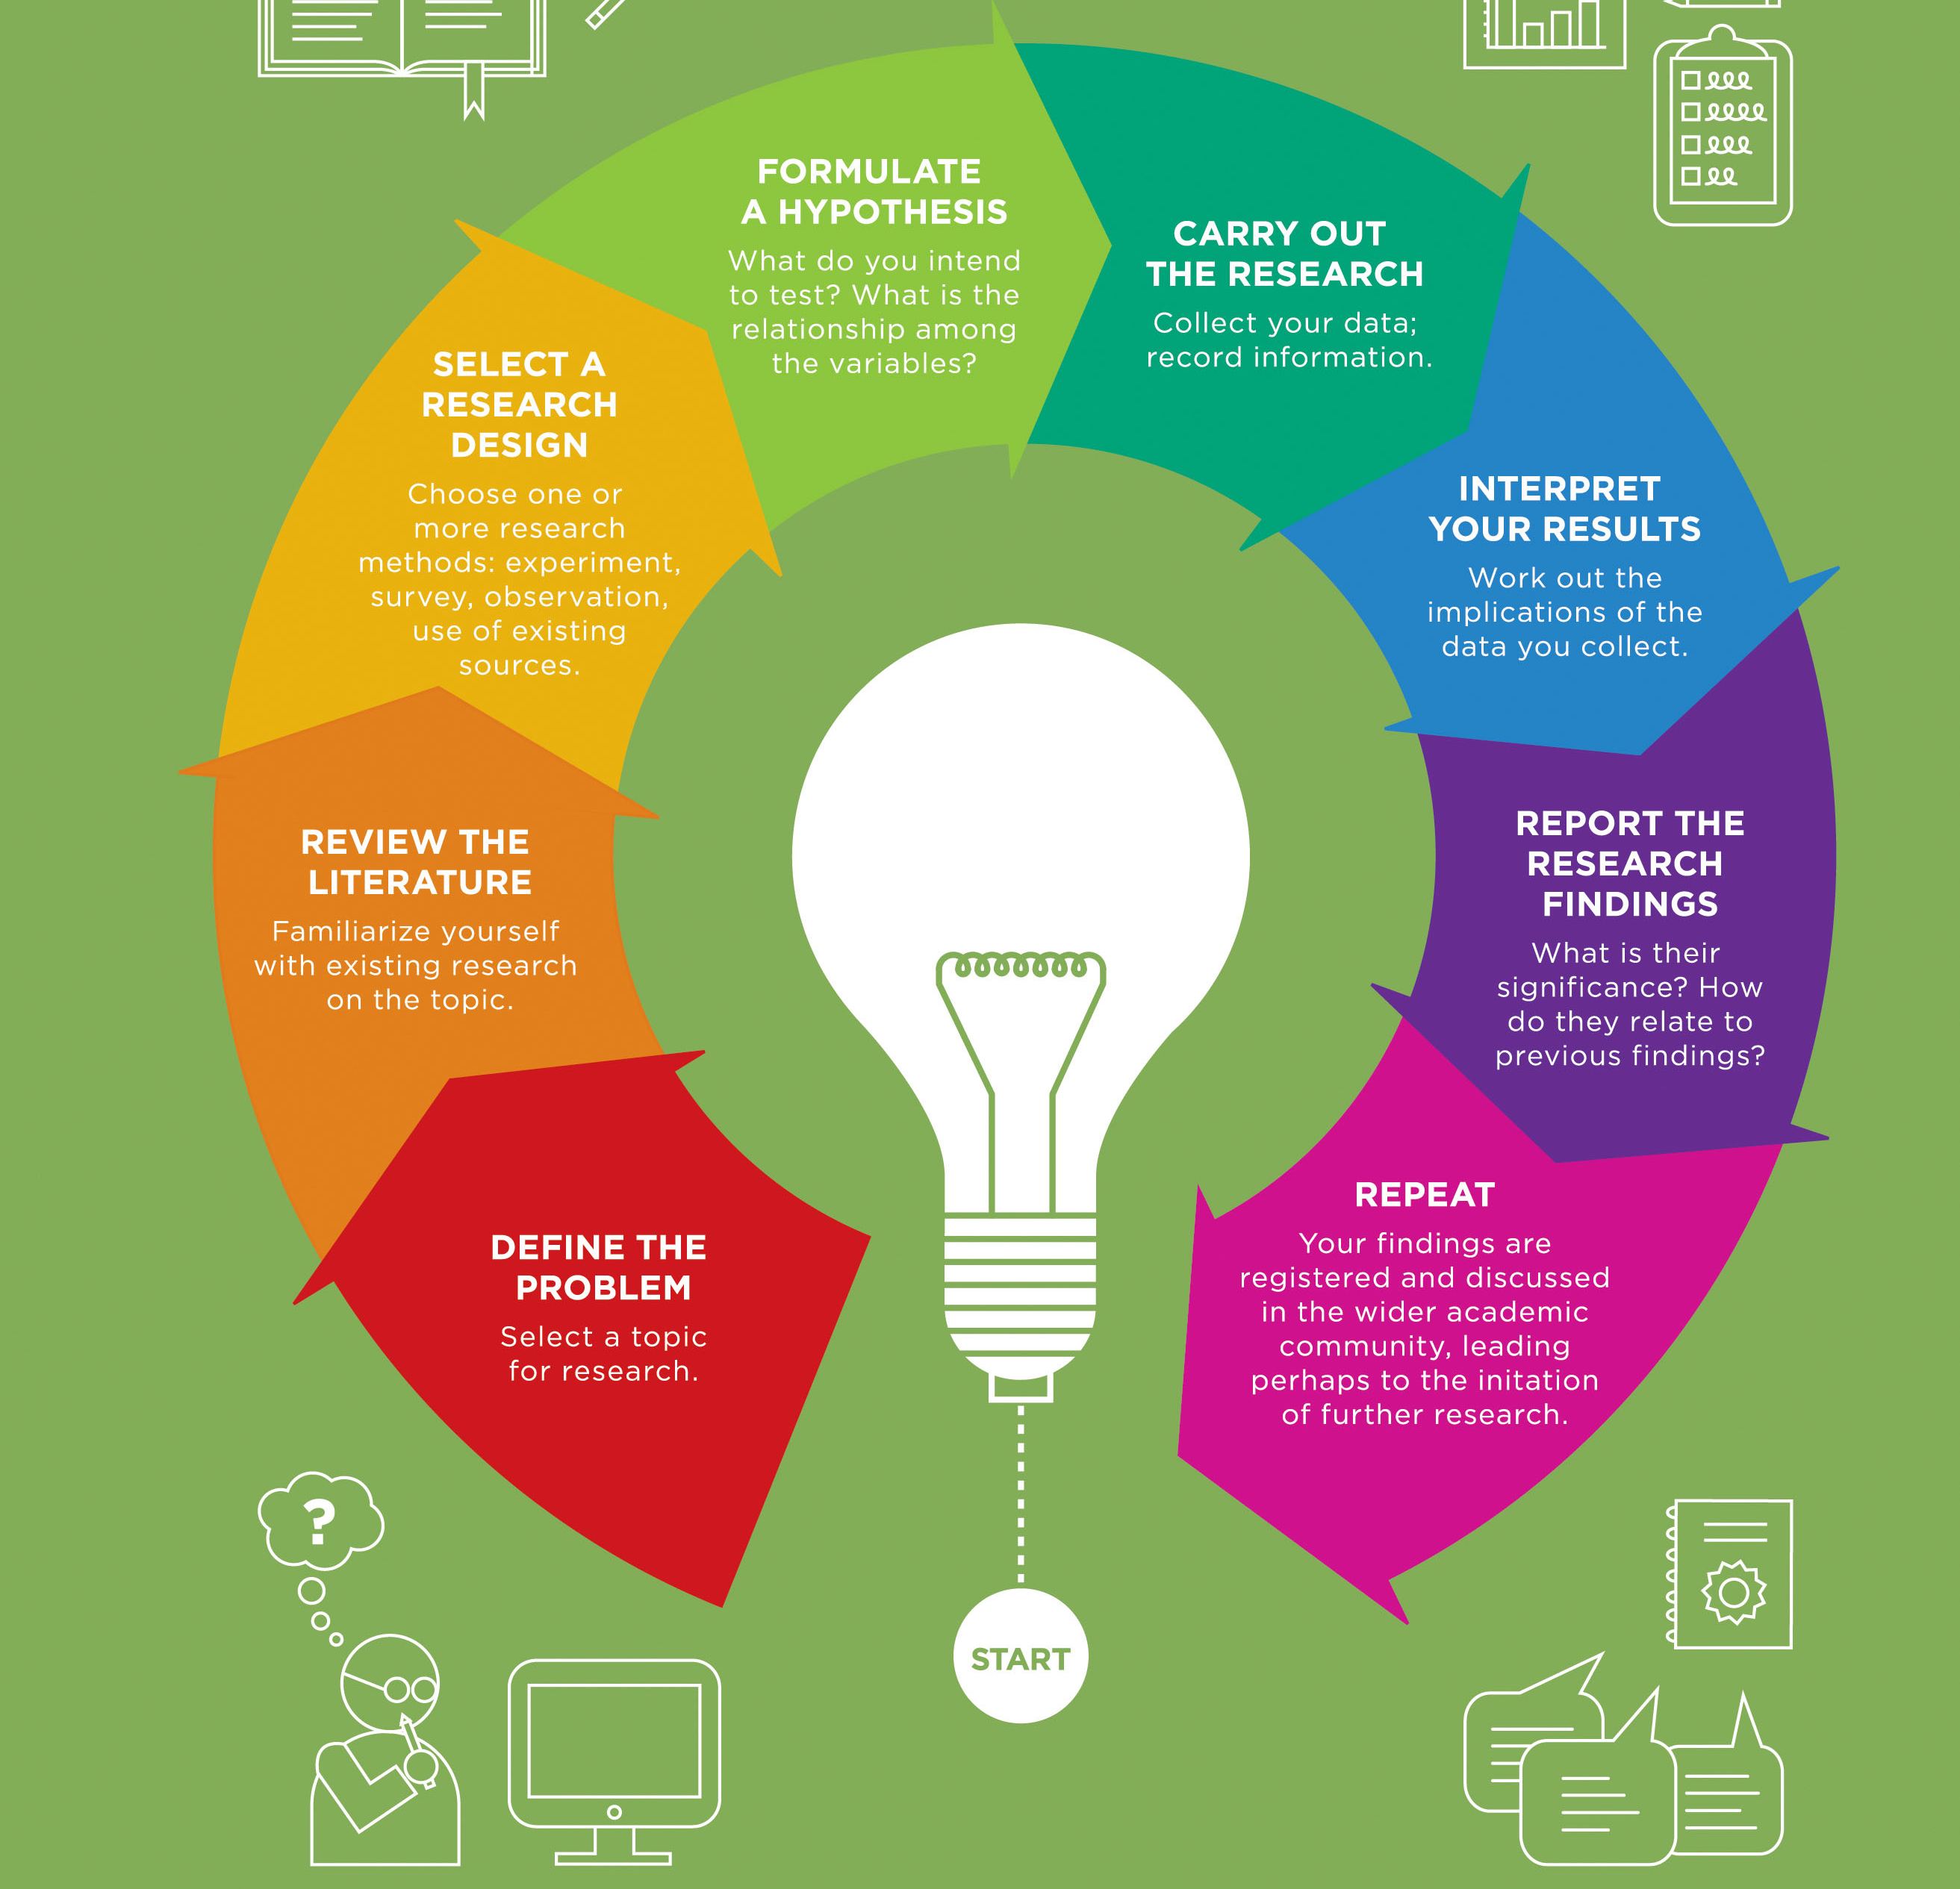
Therapeutic Process
An underlying psychological process that is clearly associated either with the progression with psychopathology or with the progression toward psychological health.
Implication: Most therapeutic mechanisms exist on a continuum from bad to good. Naming the FORM (i.e., depressive disorder) of a behavior pattern is therefore not nearly as important as naming its’ FUNCTION (i.e., emotional numbing and behavioral avoidance).
This Photo by Unknown Author is licensed under CC BY-SA-NC
This Photo by Unknown Author is licensed under CC BY-SA-NC

Slide 4
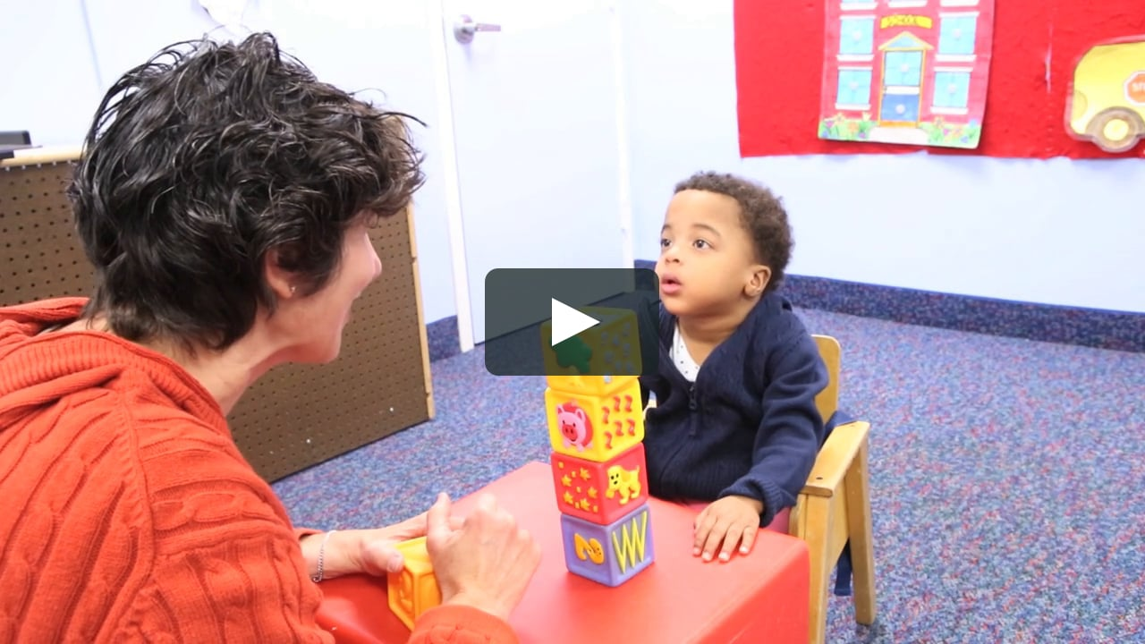
Therapeutic Intervention
A specific clinical activity that is presumed to activate, in a positive direction, an underlying therapeutic mechanism.
Seemingly different therapeutic techniques can, and do, activate the same underlying therapeutic process.
You are not doing “therapy” just because you use a clinical technique. First, it needs to link functionally to an underlying therapeutic mechanism.

Slide 5
Why Brief Interventions Anyway?
Modal number of therapy visits in US is 1!
Average number of therapy sessions is between 4-6.
Largest proportionate gains in therapy of any kind occur in first 4 sessions, with sharply diminishing returns afterwards.
40% of clients drop out of therapy before completing 4th session.
Rapid response to therapy within the first 1-3 sessions is widespread across diagnostic and age groups.
Brief versions of EST’s generally are equal, or superior, in efficacy and effectiveness compared to full protocol versions.
Take Home Message: Clients typically prefer, and benefit more from, briefer therapeutic regimes

Slide 6
Four Core Dialectical Processes In The Clinical Conversation
Contextual Sensitivity versus Contextual Insensitivity
Experiential Avoidance versus Acceptance
Automatic Self-Instructional versus Volitional Self-Instructional Control
Behavioral Inflexibility Versus Behavioral Variability

Slide 7
Sensitivity to Context
The extent to which the person sees a direct connection between self-relevant antecedents, behaviors and consequences (A-B-C)
Under conditions of rule governance, clients develop “context insensitivity”; behavior is unaffected by its consequences.
Clients believe their psychological distress is “randomly” created rather than directly linked to patterns of unworkable private and public behaviors
Many of these unworkable behaviors are socially trained and promoted, thus furthering the client’s perceptions about emotional distress being randomly experienced.
The phenomenon itself can explain much of what we know about psychopathological patterns of behavior

Slide 8
Experiential Avoidance versus Acceptance
Rule governance and context insensitivity lead directly to experiential avoidance, a socially trained rule that encourages clients to systematically avoid distressing, unwanted private experiences.
“Health” and “happiness” are viewed as the absence of distressing personal content.
Avoiding such content keeps the client from being “infected” by it and becoming even more unhealthy.
Most clients believe that ”other people” are relatively free of emotional distress and able to control or eliminate unpleasantness when it arises
Reversing context insensitivity related to rule governed avoidance behaviors is thus a prime target in process oriented brief intervention

Slide 9
Automatic Self-Instructional versus Volitional Self-Instructional Control
Most rule governed behaviors are habitual and automatic.
Most clients are not aware of the self-instructional rules they follow or the consequences of following them.
Coming into a state of sustained volitional awareness (i.e., being mindful or ”in the present” moment) may present the client with triggers for over-learned rule governed avoidance responses (antecedent private experiences) .
Most clients may lack strong connection with self-instructional rules that are powerful enough to over-ride avoidance self-instructions.
A potent intervention must provide an alternative form of self-instruction that can be sustained in the presence of avoidance based self-instructions.

Slide 10
Behavioral Inflexibility Versus Behavioral Variability
The extent to which the client can vary behavioral responses to fit the ever-changing demands of the surrounding internal (mind) and external (life space) contexts.
Constrictions in behavioral variability are at the core of psychopathological process. “Insanity is trying the same unworkable thing over and over again, believing it will eventually succeed”.
Most socially inculcated rule governed behavior is done in the service of REDUCING behavioral variability. This involves both reducing sensitivity to immediate consequences and paying more attention to following the social convention than assessing whether doing so works for the individual.
It is thus imperative that every meeting with the client leads to a behavioral experiment, something different the client is willing to try.

Slide 11
Learning To C A R E

Slide 12
Four Quadrant CARE Approach
BEHAVIOR | WORKABILITY
 |  | AVOIDANCE | ENGAGEMENT
 | Actions context | Context Behavioral avoidance (BA) reduces connection with & gaps between patient passions / needs and life outcomes. Leads to symptom of distress. | Experiment Value-consistent approach behaviors, increase positive emotion, build strength in approach behaviors and ability to persist in presence of distressing private experiences
 | Private events context | Avoidance BA is controlled by emotional avoidance rules. Paradoxical result is increase in need to avoid, Cycle of more symptoms of distress, more avoidance | Reframe: Reshape rules supporting avoidance or replace with rules supporting emotional acceptance and approach behaviors (i.e., openness and engagement)

Slide 13
CARE
BEHAVIOR | WORKABILITY
 |  | Problem Focused Interview | Solution Focused Interview
 | Actions context | Contextualize the “problem” and explore “costs” of avoidance. Establish context sensitivity (Workability) | Experiment with new approach behaviors instigated by new self-instructional rules. Teach skills that allow contingency shaped learning
 | Private events context | Assess and weaken self-instructional rules that promote emotional and behavioral avoidance | Reformulate and articulate rules that connect distress with life values. Augment rules that enable acceptance and chosen action

Slide 14
Polls
Is this interesting? Relevant?
Do you want to learn more?
This Photo by Unknown Author is licensed under CC BY

Slide 15
Video Demonstration
Pair up with a partner. Watch the video of divorced father in recovery struggling with social anxiety and avoidance. Link your observations to CARE. Use these questions to shape your discussion after the video.
What does the therapist do to establish context and consequences?
What does therapist do to uncover and influence avoidance?
How does the therapist help the client reshape self-instructions to avoid, so that self-instructions better support emotional acceptance and approach behaviors?
What does the therapist do to enhance client behavioral variability?

Slide 16
Learning CARE 20 mins.
1. Real play* a not too difficult client situation with your partner. Try the CARE FLOW.
Be conscious of where you are in the session flow; okay not to get to the end
At 15 mins, “client” will give feedback to the “therapist” about what went well, what might be improved
Therapist talks about heir experience of using the CARE sequence
2. Back to large group for questions
3. Back to break-out with partner, reverse roles.
*Real play means role playing with integrity to the role with the intention to help your partner learn.

Slide 17
Clients
Did you experience a difference in your perspective on the context of your problem?

Slide 18
Clinician
Is there something from this exercise that you plan to use in practice?

Slide 19
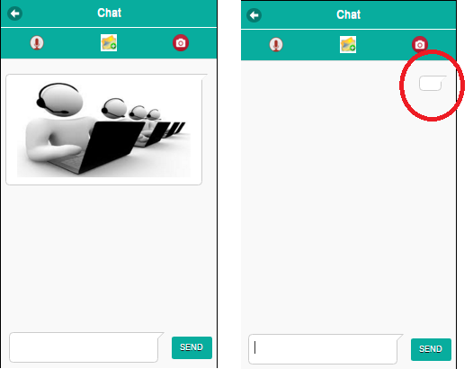
Write in the chat☺

Slide 20
Clients
Did you experience a shift from avoidance to approach?

Slide 21
Clinician
Did using the CARE flow help you do something new?

Slide 22
Summary
Brief interventions matter because we reach more people
Use the CARE approach to help people:
Become more context sensitive
Shift from avoidance to approach behaviors more often and more intentionally
Learn to recognize automatic self instructions and tune into volitional self instruction
Learn to engage in behavioral experiments that promote behavioral variability

Slide 23
Questions, Comments, Gratitude

Slide 24
Our Newest Books
https://www.appi.org/Products/Psychotherapy/Learning-Acceptance-and-Commitment-Therapy?SearchText=Acceptance%20and%20Co&sku=37173
https://www.amazon.com/Basics-Behavior-Primary-SpringerBriefs-Psychology/dp/3030320499/ref=sr_1_2?crid=3NAXHO2RPLNIB&dchild=1&keywords=basics+of+behavior+change+in+primary+care&qid=1593302806&sprefix=Basics+of+behavior+ch%2Caps%2C249&sr=8-2

Slide 25
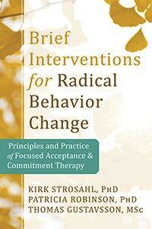
Focused ACT (fACT) Resources
Association for Contextual Behavioral Science”
http://www.contextualpsychology.org/ http://www.newharbingeronline.com/real-behavior-change-in-primary-care.html

Slide 26
Focused ACT (fACT) Resources

